Slide 1
“Data Type Default Values” &
“Choosing the Right Type
for a Column”
RedFoxTask
Team Lead: Sam Guggino
Team Members:
Abby Lee Cody Carruthers
Kevin Reiff Chase Evans

Slide 2
Default Values
A DEFAULT clause indicates a default value for a column
It can be a literal constant or an expression
Expression values are put in parentheses
For TIMESTAMP and DATETIME columns, CURRENT_TIMESTAMP can be used without parentheses
SERIAL DEFAULT VALUE is used for an integer column
An alias for NOT NULL AUTO_INCREMENT UNIQUE
BLOB, TEXT, GEOMETRY, and JSON data types can only be assigned default values if they are written as expressions

Slide 3
Rules for Expression Default Values
Literals, built in functions, and operators are allowed
Subqueries, parameters, variables, stored functions, and loadable functions are not allowed
An expression default cannot use a column that has an AUTO_INCREMENT attribute
An expression default value for one column can refer to other table columns
Exception: references to other table columns must be from columns that appear earlier in the table definition
This rule also applies to ALTER TABLE to reorder columns

Slide 4
Altering Tables
For CREATE TABLE ... LIKE and CREATE TABLE ... SELECT, the destination table uses default values from the original table
If an expression default value has a nondeterministic function, it cannot be used for statement-based replication
This includes INSERT and UPDATE
If binary logging is disabled, the statement will execute
If binary logging is enabled and binlog_format is set to STATEMENT, the statement will execute but a warning will be sent to the error log
If binlog_format is set to MIX or ROW, the statement will execute

Slide 5
Inserting Rows
To insert a new row the default value of a column with an expression value can be inserted by removing the column name or setting it to DEFAULT
The use of DEFAULT(col_name) to specify the default value for a named column can only be used for columns that have a literal default value
Not all storage engines allow expression values
ER_UNSUPPORTED_ACTION_ON_DEFAULT_VAL_GENERATED will occur

Slide 6
Implicit Default Handling
If there is no explicit DEFAULT value, MySQL will:
Define the column with DEFAULT NULL clause if the column can take NULL as a value
Define the column with no explicit DEFAULT clause if null cannot be used
For data entry into a NOT NULL column, MySQL will handle the column based on the SQL mode used if an INSERT or REPLACE statement includes no value, or an UPDATE statement sets the column to NULL:
If strict SQL mode is enabled, an error will occur
If strict SQL mode is not enabled, MySQL sets the column to the implicit default value for the column data type

Slide 7
Implicit Defaults
The SHOW CREATE TABLE statement shows which columns have an explicit DEFAULT clause
For numeric types, the default is 0
For integer or floating-point types declared with the AUTO_INCREMENT attribute, the default is the next value
For date and time types besides TIMESTAMP, the default value is the correct “zero” value for the type
This is true for TIMESTAMP if the explicit_defaults_for_timestamp is enabled
If it is not enabled, the default value for TIMESTAMP is the current date and time
Besides ENUM, the default value is the empty string
For ENUM, the default is the first enumeration value

Slide 8
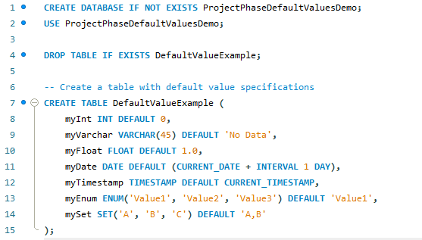
Default Demo

Slide 9
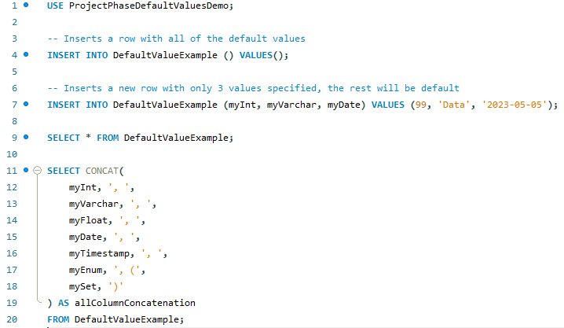
Default Demo (cont)

Slide 10
Choosing the Right Type for a Column
For optimum storage, you should try and use the most precise type in all cases
Example: If an integer column is used for values 1-99999, MEDIUMINT UNSIGNED is the best type to use
All basic calculations (+, -, *, and /) with DECIMAL columns are done with precision of 65 decimal digits
When accuracy does not matter but speed does, the DOUBLE type may be good enough
For high precision, you can always convert to a fixed-point type stored in a BIGINT
This enables you to do all calculations with 64-bit integers and then convert the results back to floating point values as necessary

Slide 11
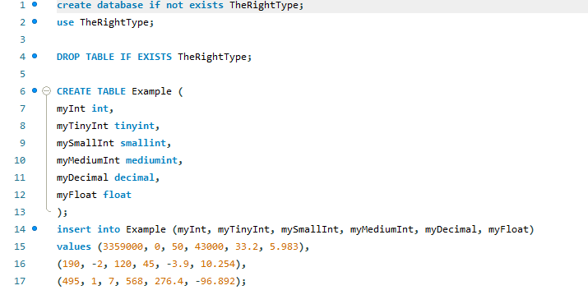
Data Types for a Column (cont.)

Slide 12
